Slide 1
Probability Theory: Uncertainty Measure
Lecture Module 18

Slide 2
Uncertainty
Most intelligent systems have some degree of uncertainty associated with them.
Uncertainty may occur in KBS because of the problems with the data.
  Data might be missing or unavailable.
  Data might be present but unreliable or ambiguous due to measurement errors, multiple conflicting measurements etc.
  The representation of the data may be imprecise or inconsistent.
  Data may just be expert's best guess.
  Data may be based on defaults and the defaults may have exceptions.

Slide 3
Cont…
Given numerous sources of errors, the most KBS requires the incorporation of some form of uncertainty management.
For any form of uncertainty scheme, we must be concerned with three issues.
  How to represent uncertain data?
  How to combine two or more pieces of uncertain data?
  How to draw inference using uncertain data?
Probability is the oldest theory with strong mathematical basis.
Other methods for handling uncertainty are Bayesian belief network, Certainty factor theory etc.

Slide 4
Probability Theory
Probability is a way of turning opinion or expectation into numbers.
It lies between 0 to 1 that reflects the likelihood of an event.
The chance that a particular event will occur = the number of ways the event can occur divided by the total number of all possible events.
Example: The probability of throwing two successive heads with a fair coin is 0.25
  Total of four possible outcomes are :
HH, HT, TH & TT
  Since there is only one way of getting HH,
  probability = ¼ = 0.25

Slide 5
Evant
Event: Every non-empty subset A (of sample space S) is called an event.
  null set Φ is an impossible event.
  S is a sure event
P(A) is notation for the probability of an event A.
P(Φ) = 0 and P(S) = 1
The probabilities of all events S = {A1, A2, …, An} must sum up to certainty i.e. P(A1) + … + P(An) = 1
Since the events are the set, it is clear that all set operations can be performed on the events.
If A and B are events, then
  A ∩ B ; A∪ B and A' are also events.
  A - B is an event "A but not B
  Events A and B are mutually exclusive, if A ∩ B=Φ

Slide 6
Axioms of Probability
Let S be a sample space, A and B are events.
  P(A) ≥ 0
  P(S) = 1
  P(A’ ) = 1 - P(A)
  P(A ∪ B ) = P(A) + P(B) – P(A ∩ B)
  If events A and B are mutually exclusive, then
  P(A ∪ B ) = P(A) + P(B),
In general, for mutually exclusive events A1,…,An in S
P(A1 ∪ A2 ∪… ∪ An ) = P(A1) + P(A2) + …+ P(An)

Slide 7
Joint Probability
Joint Probability of the occurrence of two independent events is written as P (A and B) and is defined by
  P(A and B) = P(A ∩ B) = P(A) * P(B)
Example: We toss two fair coins separately.
Let P(A) = 0.5 , Probability of getting Head of first coin
P(B) = 0.5, Probability of getting Head of second coin
Probability (Joint probability) of getting Heads on both the coins is
= P(A and B)
= P(A) * P(B) = 0.5 X 0.5 = 0.25
The probability of getting Heads on one or on both of the coins i.e. the union of the probabilities P(A) and P(B) is expressed as
P(A or B) = P(A ∪ B) = P(A) + P(B) - P(A) * P(B)
= 0.5 X 0.5 - 0.25
= 0.75

Slide 8
Conditional Probability
It relates the probability of one event to the occurrence of another i.e. probability of the occurrence of an event H given that an event E is known to have occurred.
Probability of an event H (Hypothesis), given the occurrence of an event E (evidence) is denoted by P(H | E) and is defined as follows:
Number of events favorable to H which are also favorable to E
P(H | E) =
No. of events favorable to E
P(H and E)
=
P(E)

Slide 9
Example
What is the probability of a person to be male if person chosen at random is 80 years old?
The following probabilities are given
  Any person chosen at random being male is about 0.50
  probability of a given person be 80 years old chosen at random is equal to 0.005
  probability that a given person chosen at random is both male and 80 years old may be =0.002
The probability that an 80 years old person chosen at random is male is calculated as follows:
P(X is male | Age of X is 80)
= [P(X is male and the age of X is 80)] / [P(Age of X is 80)]
= 0.002 / 0.005 = 0.4

Slide 10
Conditional Probability with Multiple Evidences
If there are n evidences and one hypothesis, then conditional probability is defined as follows:
P(H and E1 … and En)
P(H | E1 and … and En) =
P(E1 and … and En)

Slide 11
Bayes’ Theorem
Bayes theorem provides a mathematical model for this type of reasoning where prior beliefs are combined with evidence to get estimates of uncertainty.
This approach relies on the concept that one should incorporate the prior probability of an event into the interpretation of a situation.
It relates the conditional probabilities of events.
It allows us to express the probability P(H | E) in terms of the probabilities of P(E | H), P(H) and P(E).
P(E|H) * P(H)
P(H|E) = P(E)

Slide 12
Proof of Bayes’ Theorem
Bayes’ theorem is derived from conditional probability.
Proof: Using conditional probability
P(H|E) = P(H and E) / P(E)
⇒ P(H|E) * P(E) = P(H and E) (1)
Also P(E|H) = P(E and H) / P(H)
⇒ P(E|H) * P(H) = P(E and H) (2)
From Eqs (1) and (2), we get
P(H|E) * P(E) = P(E|H) * P(H)
Hence, we obtain
P(E|H) * P(H)
P(H|E) =
P(E)

Slide 13
Extension of Bayes’ Theorem
Consider one hypothesis H and two evidences E1 and E2.
The probability of H if both E1 and E2 are true is calculated by using the following formula:
P(E1| H) * P(E2| H) * P(H)
P(H|E1 and E2) = P(E1 and E2)

Slide 14
Contd..
Consider one hypothesis H and Multiple evidences E1,…., En.
The probability of H if E1,…, En are true is calculated by using the following formula:
P(E1| H) * … * P(En | H) * P(H)
P(H|E1 and … and En) = P(E1 and … and En)

Slide 15
Example
Find whether Bob has a cold (hypotheses) given that he sneezes (the evidence) i.e., calculate P(H | E).
Suppose that we know / given the following.
P(H) = P (Bob has a cold) = 0.2
P(E | H)= P(Bob was observed sneezing
| Bob has a cold) = 0.75
P(E | ~H)= P(Bob was observed sneezing
| Bob does not have a cold) = 0.2
Now
P(H | E) = P(Bob has a cold | Bob was observed sneezing)
= [ P(E | H) * P(H) ] / P(E)

Slide 16
Cont…
We can compute P(E) as follows:
P(E) = P( E and H) + P( E and ~H)
= P(E | H) * P(H) + P(E | ~H) * P(~H)
= (0.75)(0.2) + (0.2) (0.8) = 0.31
  Hence P(H | E) = [(0.75 * 0.2)] / 0.31 = 0.48387
  We can conclude that “Bob’s probability of having a cold given that he sneezes” is about 0.5
Further it can also determine what is his probability of having a cold if he was not sneezing?
P(H | ~E) = [P(~E | H) * P(H)] / P(~E) = [(1 – 0.75) * 0.2] / (1 – 0.31)
= 0.05 / 0.69 = 0.072
  Hence “Bob’s probability of having a cold if he was not sneezing” is 0.072

Slide 17
Advantages and Disadvantages of Bayesian Approach
Advantages:
They have sound theoretical foundation in probability theory and thus are currently the most mature of all certainty reasoning methods.
Also they have well-defined semantics for decision making.
Disadvantages:
They require a significant amount of probability data to construct a KB.
  For example, a diagnostic system having 50 detectable conclusions (R) and 300 relevant and observable characteristics (S) requires a minimum of 15,050 (R*S + R) probability values assuming that all of the conclusions are mutually exclusive.

Slide 18
Cont…
If conditional probabilities are based on
  statistical data, the sample sizes must be sufficient so that the probabilities obtained are accurate.
  human experts, then question of values being consistent & comprehensive arise.
The reduction of the associations between the hypothesis and evidence to numbers also eliminates the knowledge embedded within.
  The ability to explain its reasoning and to browse through the hierarchy of evidences to hypothesis to a user are lost and

Slide 19
Probabilities in Facts and Rules of Production System
Some Expert Systems use Bayesian theory to derive further concepts.
  We know that KB = facts + Rules
We normally assume that the facts are always completely true but facts might also be probably true.
Probability can be put as the last argument of a predicate representing fact.
Example:
a fact "battery in a randomly picked car is 4% of the time dead" in Prolog is expressed as
battery_dead (0.04).
  This fact indicates that ‘battery is dead’ is sure with probability 0.04.

Slide 20
Probability in Rules
If_then rule in rule-based Systems can incorporate probability as follows:
  if X is true then Y can be concluded with probability P
Examples:
Consider the following probable rules and their corresponding Prolog representation.
  "if 30% of the time when car does not start, it is true that the battery is dead "
battery_dead (0.3) :- ignition_not_start(1.0).
  Here 30% is rule probability. If right hand side of the rule is certain, then we can even write above rule as:
battery_dead(0.3) :- ignition_not_start.
  "the battery is dead with same probability that the voltmeter is outside the normal range"
battery_dead(P) :-voltmeter_measurment_abnormal(P).

Slide 21
Cumulative Probabilities
Combining probabilities from the facts and successful rules to get a cumulative probability of the battery being dead is an important issue.
  We should gather all relevant rules and facts about the battery is dead.
The probability of a rule to succeed depends on probabilities of sub goals on the right side of a rule.
  The cumulative probability of conclusion can be calculated by using and-combination.
In this case, probabilities of sub goals in the right side of rule are multiplied, assuming all the events are independent of each other using the formula
Prob(A and B and C and .....) = Prob(A) * Prob(B) * Prob(C) * ...

Slide 22
Cont…
The rules with same conclusion can be uncertain for different reasons.
If there are more than one rules with the same predicate name having different probabilities, then in cumulative likelihood of the above predicate can be computed by using or-combination.
To get overall probability of predicate, the following formula is used to get 'or' probability if events are mutually independent.
Prob(A or B or C or ...)
= 1 - [(1 - Prob(A)) (1 - Prob(B)) (1 - Prob(C))....]

Slide 23
Examples
1. "half of the time when a computer does not work, then the battery is dead"
battery_dead(P):-computer_dead(P1), P is P1*0.5.
  Here 0.5 is a rule probability.
2. "95% of the time when a computer has electricalproblem and battery is old, then the battery is dead"
battery_dead(P) :- electrical_prob(P1), battery_old(P2), P is P1 * P2 * 0.95.
  Here 0.95 is a rule probability.
The rule probability can be thought of hidden and is combined along with associated probabilities in the rule.

Slide 24
Prolog Programs for Cumulative Probabilities
And-combination: collect all the probabilities in a list and compute the product of these to get and-comb effect.
and_comb([P], P).
and_comb([H | T], P) :- and_comb(T, P1), P is P1 * H.
Assumption is that the sub goals in the rule are independent of each other.
Or-combination: Compute probabilities of all the rules with the same predicate name as head in a list and compute or_comb probability.
or_comb([P], P).
or_comb([H|T],P):-or_comb(T,P1),P is 1-((1-H) * (1-P1)).

Slide 25
Examples
Consider the following rules and facts.
get(0.6) :- first.
get(0.8) :- second, third.
get(0.5) :- first, fourth.
We can define another predicate for computing overall probability or likelihood of 'get' using or_comb.
overall_get (P) :- findall(P1, get(P1), L), or_comb(L, P).
?- overall_get(P)
Ans: P = 0.960

Slide 26
Cont…
Example: Consider rules with and-combination as follows:
get(0.6) :- first.
get(0.8) :- second.
get(P) :- third(P1), fourth(P2), and_comb([P1, P2, 0.8], P).
first.
second.
third(0.5).
fourth(0.6).
overall_get(P) :- findall(P1, get(P1), L), or_comb(L, P).
?- overall_get(P).
?- findall(P1, get(P1), L), or_comb(L, P)
Ans: L = [0.6, 0.8, 0.24]
P = 0.9392

Slide 27
    Production System for Diagnosis of malfunctioning Equipment using Probability
Let us develop production system for diagnosis of malfunctioning of television using probabilities.
We have to identify situations when television is not working properly. We broadly imagine one of two things may be improperly adjusted.
- the controls (knobs and switches)
- the receiver (antenna or cable)
Let us estimate probabilities of these two things.
Knobs adjustment:
Knobs might be adjusted wrong on television because of the following reasons (by no mean exhaustive)
1. If television is old and require frequent adjustment.
2. Unusual usage (i.e., any thing strange has happened lately that required adjustment of the knobs).
3. If children use your set and they play with the knobs.

Slide 28
Diagnosis of Malfunctioning Equipment using Probability
Let us develop rule based system for diagnosis of malfunctioning of landline telephone using probabilities.
Identify situations when telephone is not working properly.
Broadly imagine one of the following things may be the reasons
  Faulty Instrument
  Problem with exchange
  Broken cable
Must note that these rules are to be carefully designed in consultation with domain expert.

Slide 29
Few Rules from expert for Instrument
Rule1: If instrument is old and has been repaired in the past many times then it is 40% sure that fault lies with the instrument.
telephone_not_working(0.4) :- ask(tele_history).
Rule2: If instrument is fallen on the ground and broke then it is 80% sure that fault lies with the instrument.
telephone_not_working(0.8) :- ask(tele_broken).

Slide 30
Rules – Cont…
Rule3: If children are present and use your set and play with the key pad with some probability, then it is 80% sure that the instrument is faulty because of unusual usage.
telephone_not_working(P) :- ask(children_present, P1), ask(children_keypad, P2),
and_comb([P1, P2, 0.8], P).
This rule says that when both the conditions hold (children are present and children play with key pads) with some probabilities, then it means, "it is 80% sure that the instrument is faulty ".

Slide 31
Cont…
Finally get the cumulative probability for telephone not working because of the instrument fault.
We need to combine probabilities of all the rules using or-combination.
The corresponding rule is:
instrument_faulty(P) :- findall(X, telephone_not_working(X), L), or_comb(L, P).
The final rule for diagnosis for instrument faulty is assumed to be 70% sure might be written as follows:
diagnosis('Instrument is faulty', P) :- instrument_faulty(P1), and_comb([P1, 0.7], P).

Slide 32
Rules – Cont…
Let us consider other kinds of telephone diagnosis such as exchange, cable connection etc.
exchange_probability(0.99) :- ask(exchange_problem).
exchange_probability (0.5) :- ask(connecting_switch_problem).
overall_exchage_probability(P):-
findall(X, exchange_probabilty(X), L),
or_combination(L, P).
cable_broken_probabilty (0.98):-
ask(cable_old), ask(if_storm_recently).
cable_broken_probability (0.3):- ask(recent_furniture_rearranging).
overall_cable_probabilty(P):-
findall(X, cable_broken_probability(X), L),
or_combination(L, P).

Slide 33
Rules for Diagnosis
Rule1: Cable faulty is 80% sure :
diagnosis( 'Cable_problem', P):- overall_cable_probabilty(P1),
and_comb([P1, 0.8], P).
Rule2: Exchange problem is 90% sure:
diagnosis( 'Exchange_problem', P):- overall_exchange_probabilty(P1),
and_comb([P1, 0.9], P).
To run such a system, invoke a Goal as:
?- diagnosis(D, P).

Slide 34
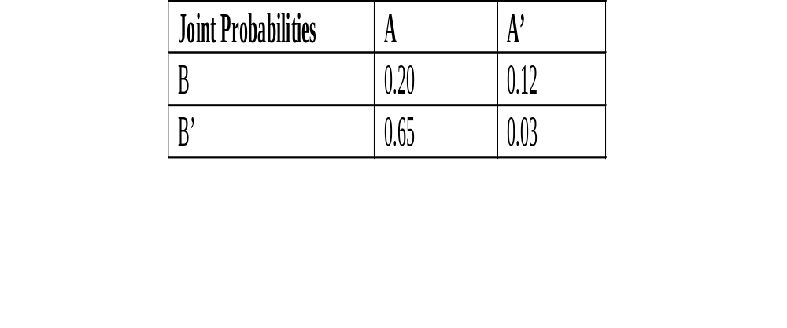
Bayesian Belief Network
Joint probability distribution of two variables A and B are given in the following Table
Joint probability distribution for n variables require 2^{n} entries with all possible combinations.
The time and storage requirements for such computations become impractical as n grows.

Slide 35
Contd..
Inferring with such large numbers of probabilities does not seem to model human process of reasoning.
Human tends to single out few propositions which are known to be causally linked when reasoning with uncertain beliefs.
This leads to the concept of forming belief network called a Bayesian belief network.
It is a probabilistic graphical model that encodes probabilistic relationships among set of variables with their probabilistic dependencies.
This belief network is an efficient structure for storing joint probability distribution.

Slide 36
Definition of BBN
It is a acyclic (with no cycles) directed graph where the nodes of the graph represent evidence or hypotheses and arc connecting two nodes represents dependence between them.
If there is an arc from node X to another node Y (i.e., X →Y), then X is called a parent of Y, and Y is a child of X.
The set of parent nodes of a node X_{i} is represented by parent_nodes(X_{i}).

Slide 37
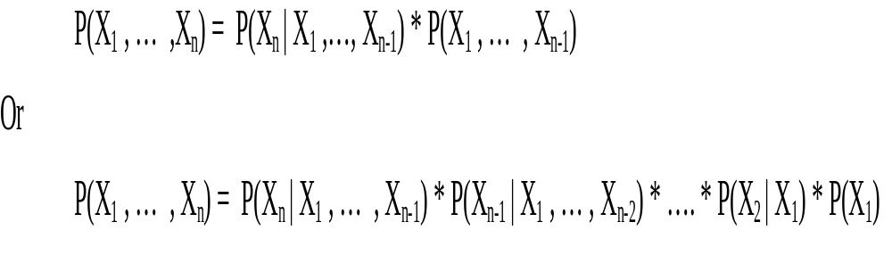
Joint Probability of n variables
Joint probability for ‘n’ variables (dependent or independent) is computed as follows.
For the sake of simplicity we write P(X₁ , … , X_{n}) instead of P(X₁ and … and X_{n}).

Slide 38
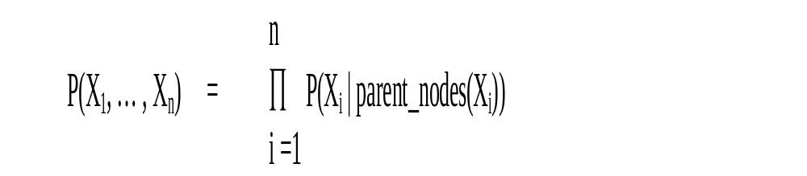
Joint Probability of ‘n’ Variables using B-Network
In Bayesian Network, the joint probability distribution can be written as the product of the local distributions of each node and its parents such as:
This expression is reduction of joint probability formula of ‘n’ variables as some of the terms corresponding to independent variables will not be required.

Slide 39
Cont…
If node Xi has no parents, its probability distribution is said to be unconditional and it is written as P(Xi) instead of P(Xi | parent_nodes(Xi)).
Nodes having parents are called conditional.
If the value of a node is observed, then the node is said to be an evidence node.
Nodes with no children are termed as hypotheses node and nodes with no parents are called independent nodes.

Slide 40
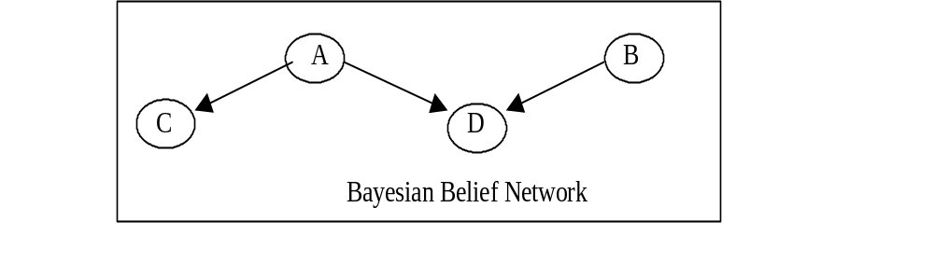
Example
The following graph is a Bayesian belief network.
  Here there are four nodes with {A, B} representing evidences and {C, D} representing hypotheses.
  A and B are unconditional nodes and C and D are conditional nodes.

Slide 41
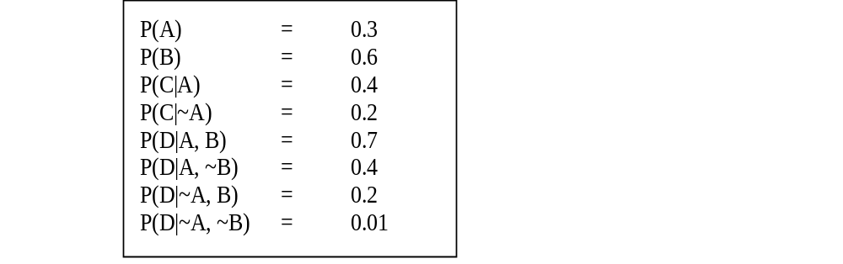
Cont...
To describe above Bayesian network, we should specify the following probabilities.

Slide 42
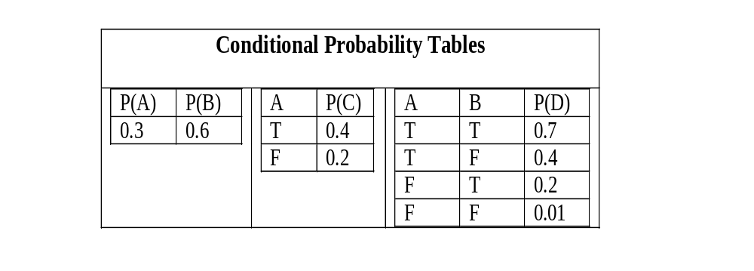
Cont…
They can also be expressed as conditional probability tables as follows:

Slide 43
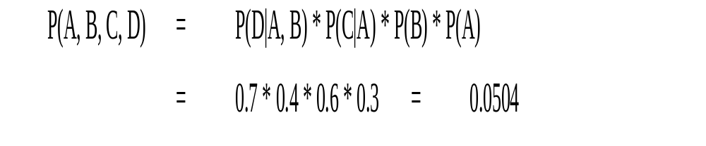
Cont…
Using Bayesian belief network on previous slide, only 8 probability values in contrast to 16 values are required in general for 4 variables {A, B, C, D} in joint distribution probability.
Joint probability using Bayesian Belief Network is computed as follows:

Slide 44
Example of Simple B-Network
Suppose that there are three events namely earthquake, burglary or tornado which could cause ringing of alarm in a house.
This situation can be modeled with Bayesian network as follows.
All four variables have two possible values T (for true) and F (for false).
  Here the names of the variables have been abbreviated to A = Alarm, E = Earthquake, and B = Burglary and T = Tornado.

Slide 45
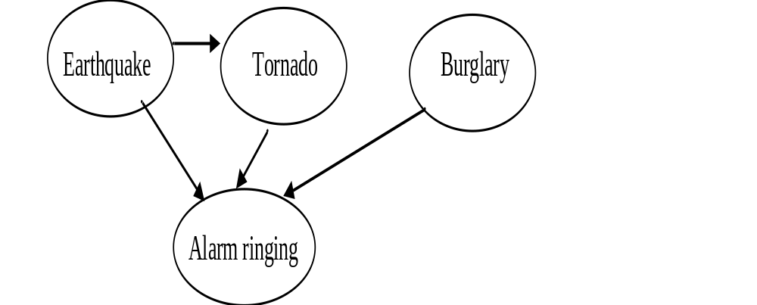
Cont…

Slide 46
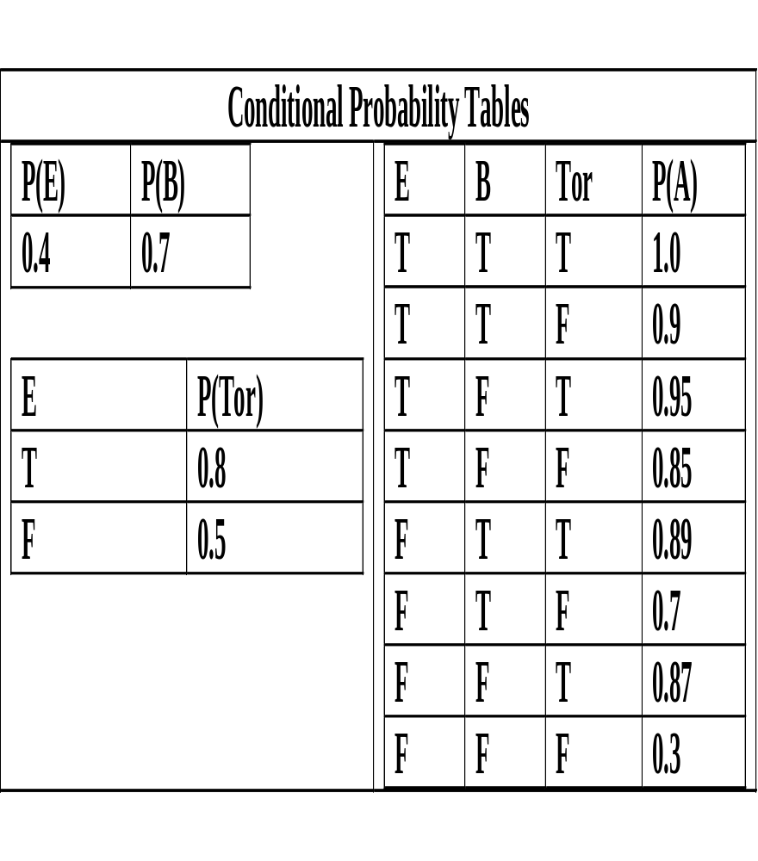
Cont…
Table contains the probability values representing complete Bayesian belief network.
Prior probability of ‘earthquake’ is 0.4 and if it is earthquake then probability of ‘tornado’ is 0.8. and if not then the probability of ‘earthquake’ is 0.5.

Slide 47
Cont…
The joint probability is computed as follows:
P(E, B, T, A) = P(A| E, B, T) * P(T|E) * P(E) * P(B)
= 1.0 * 0.8 * 0.4 * 0.7 = 0.214
Using this model one can answer questions using the conditional probability formula as follows:
  "What is the probability that it is earthquake, given the alarm is ringing?" P(E|A)
  "What is the probability of burglary, given the alarm is ringing?" P(B|A)
  "What is the probability of ringing alarm if both earthquake and burglary happens?" P(A|E, B)

Slide 48
Advantages of Bayesian B Network
It can easily handle situations where some data entries are missing as this model encodes dependencies among all variables.
It is intuitively easier for a human to understand direct dependencies than complete joint distribution.
It can be used to learn causal relationships.
It is an ideal representation for combining prior knowledge (which often comes in causal form) and data because the model has both causal and probabilistic semantics.

Slide 49
Disadvantages of BB Network
The probabilities are described as a single numeric point value. This can be a distortion of the precision that is actually available for supporting evidence.
There is no way to differentiate between ignorance and uncertainty. These are distinct two different concepts and be treated as such.
The quality and extent of the prior beliefs used in Bayesian inference processing are major shortcomings.
Reliability of Bayesian network depends on the reliability of prior knowledge.
Selecting the proper distribution model to describe the data has a notable effect on the quality of the resulting network. Therefore, selection of the statistical distribution for modeling the data is very important.

Slide 50
Certainty Factor Theory
Certainty factor theory provides another way of measuring uncertainty by describing a practical way of compromising on pure Bayesian system.
Certainty factor is based on a number of observations.
In traditional probability theory, the sum of confidence for a relationship and against a relationship must add up to 1.
In practical situation, an expert might have some confidence about some relationship being true and have no idea about the relationship being untrue.
Confidence measures correspond to the informal evaluations that human experts attach to their conclusions, such as 'it is probably or likely true‘.

Slide 51
Contd…
The certainty factor is based on 'confidence for' and 'confidence against'
The MB[H, E] is a measure of belief in the range [0, 1] in hypothesis H given the evidence E.
  If evidence supports it fully then MB[H, E] = 1 and it is zero if the evidence fails to support the hypothesis.
Similarly, MD[H, E] is a measure of disbelief in the range [0, 1] in hypothesis H given the evidence E.
  It measures the extent to which the evidence E supports the negation of the hypothesis H.
It is to be noted that MD is not compliment of MB.

Slide 52
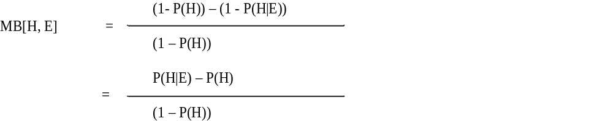
Measure of belief
The measure of belief calculates the relative decrement of disbelief in a given hypothesis H due to some evidence E.
It may be intuitively defined as follows:

Slide 53
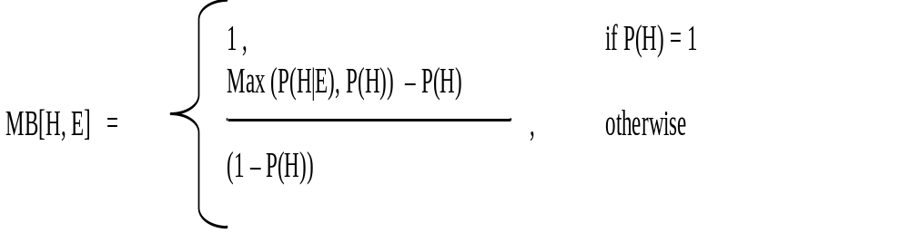
Cont…
In order to avoid getting a negative value of belief, we can modify the above definition to obtain positive value of measure as follows:

Slide 54
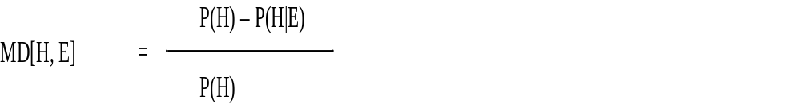
Measure of disbelief
The measure of disbelief (MD) is similarly defined as the relative decrement of belief in a given hypothesis H due to some evidence E. It may be represented as follows:
It may be intuitively defined as follows:

Slide 55
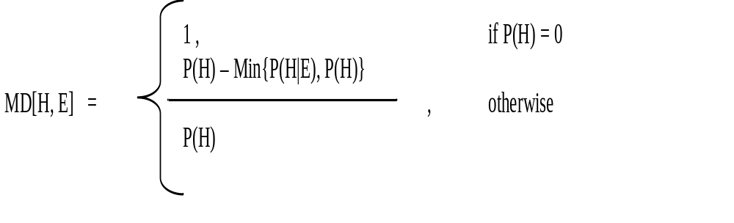
Cont…
Alternatively,

Slide 56
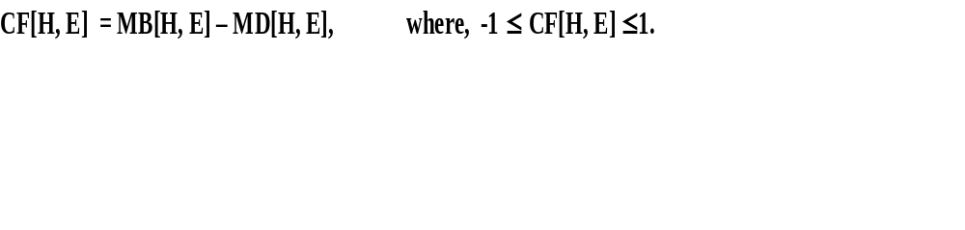
Certainty Factor
Certainty factor is defined as difference of MB and MD.
Positive certainty factor indicates evidence for the validity of the hypothesis, where evidence implies anything that is used to determine the truth of hypothesis.
  If CF = 1, then the hypothesis is said to be true, while if CF = –1, the hypothesis is considered to be false.
  Moreover, if CF = 0, then there is no evidence regarding whether the hypothesis is true or false.

Slide 57
Contd…
For computing CF in general, we need to determine the mechanism for handling the following three cases:
  Certainty factor when there are two evidences supporting hypothesis H. It is called incrementally acquired evidence.
  Certainty factor for combination of two hypotheses based on the same evidence.
  Certainty factor for chained rule.

Slide 58
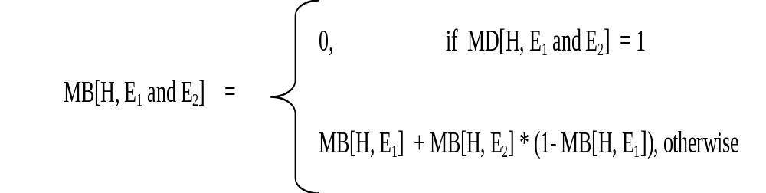
Two Evidences supporting hypothesis
Case1: Incrementally acquired evidence
Compute CF(H, E1 and E2).
Let us first compute MB(H, E1 and E2) and MD(H, E1 and E2)
Similarly MD is defined

Slide 59
Example
Suppose we make an initial observation E1 that confirms our belief in H with MB[H, E1) = 0.4 and MD(H, E1) = 0. Consider second observation E2 that also confirms H with MB[H, E2) = 0.3. Then CF(H, E1) = 0.4
MB(H, E1 and E2) = MB(H, E1) + MB(H, E2) * (1 – MB(H, E1))
= 0.4 + 0.3 * (1-MB(H, E1))
= 0.4 +0.18 = 0.58
and
MD(H, E1 and E2) = 0.0
Therefore,
CF(H, E1 and E2) = 0.58
Here we notice that slight confirmatory evidence can larger certainty factor.

Slide 60
Cont…
For other two cases refer to book.
  Case 2: There are two hypotheses H1 and H2 based on the same evidence E. Find CF for conjunction and disjunction of hypotheses.
  Case 3: In chained rule, the rules are chained together with the result that the outcome of one rule is input of another rule. For example, if the outcome of an experiment is treated as an evidence for some hypothesis i.e., E1 → E2 → H

Slide 61
Dempster–Shafer Theory
It is a mathematical theory of evidence.
It allows one to combine evidence from different sources and arrive at a degree of belief.
Belief function is basically a generalization of the Bayesian theory of probability.
Belief functions allow us to base degrees of belief or confidence for one event on probabilities of related events, whereas Bayesian theory requires probabilities for each event.
These degrees of belief may or may not have the mathematical properties of probabilities.

Slide 62
Cont…
The difference between them will depend on how closely the two events are related.
It also uses numbers in the range [0, 1] to indicate amount of belief in a hypothesis for a given piece of evidence.
Degree of belief in a statement depends upon the number of answers to the related questions containing the statement and the probability of each answer.
In this formalism, a degree of belief (also referred to as a mass) is represented as a belief function rather than a Bayesian probability distribution

Slide 63
Example
Mary and John are friends.
  Suppose Mary tells John that his car is stolen. Then John’s belief on the truth of this statement will depend on the reliability of Mary. But it does not mean that the statement is false if Mary is not reliable.
  Assume that probability of John’s opinion about the reliability of Mary is given as 0.85. Then the probability of Mary to be unreliable for John is 0.15.
  So her statement justifies a 0.85 degree of belief that a John’s car is stolen and John has no reason to believe that his car is not stolen so it is zero degree of belief that John’s car is not stolen.
  This zero does not mean that John is sure that his car is not stolen as in the case of probability, 0 would mean that John is sure that his car is not stolen. The values 0.85 and the 0 together constitute a belief function.

Slide 64
Dempster Theory Formalism
Let U be the universal set of all hypotheses, propositions, or statements under consideration.
  The power set P(U), is the set of all possible subsets of U, including the empty set represented by φ.
  The theory of evidence assigns a belief mass to each subset of the power set.
A function m: P(U) → [0,1] is called a basic belief assignment (BBA) function. It satisfies the following axioms:
  m(φ) = 0 ; ∑ m(A) = 1, ∀A ∈ P(U)
The value of m(A) is called mass assigned to A on the unit interval.
It makes no additional claims about any subsets of A, each of which has, by definition, its own mass.

Slide 65
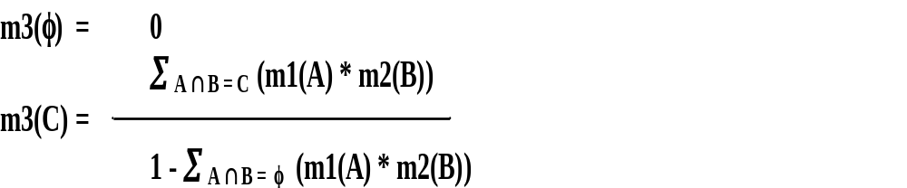
Dempster's Rule of Combination
The original combination rule, known as Dempster's rule of combination, is a generalization of Bayes' rule.
Assume that m1 and m2 are two belief functions used for representing multiple sources of evidences for two different hypotheses.
Let A, B ⊆ U, such that m1(A) ≠ 0, and m2(B) ≠ 0.
The Dempster's rule for combining two belief functions to generate an m3 function may be defined as:

Slide 66
Cont…
This belief function gives new value when applied on the set C = A ∩ B.
The combination of two belief functions is called the joint mass.
  Here m3 can also be written as (m1 ο m2).
The expression [ ∑ _{A ∩ B = φ} (m1(A) * m2(B))] is called normalization factor.
  It is a measure of the amount of conflict between the two mass sets.
The normalization factor has the effect of completely ignoring conflict and attributing any mass associated with conflict to the null set.

Slide 67
Example : Diagnostic System
Suppose we have mutually exclusive hypotheses represented by a set U = {flu, measles, cold, cough}.
The goal is to assign or attach some measure of belief to the elements of U based on evidences.
  It is not necessary that particular evidence is supporting some individual element of U but rather it may support subset of U.
  For example, an evidence of ‘fever’ might support {flu, measles}.
So a belief function ‘m’ is defined for all subsets of U.
The degree of belief to a set will keep on changing if we get more evidences supporting it or not.

Slide 68
Example : Cont…
Initially assume that we have no information about how to choose hypothesis from the given set U.
So assign m for U as 1.0 i.e., m(U) = 1.0
  This means we are sure that answer is somewhere in the whole set U.
Suppose we acquire evidence (say fever) that supports the correct diagnosis in the set {flu, measles} with its corresponding ‘m’ value as 0.8.
Then we get m({flu, measles}) = 0.8 and m(U) = 0.2.

Slide 69
Cont…
Let us define two belief functions m1 and m2 based on evidence of fever and on evidence of headache respectively as follows:
m1({flu, measles}) = 0.8
m1(U) = 0.2
m2({flu, cold}) = 0.6
m2(U) = 0.4
We can compute their combination m3 using these values.

Slide 70
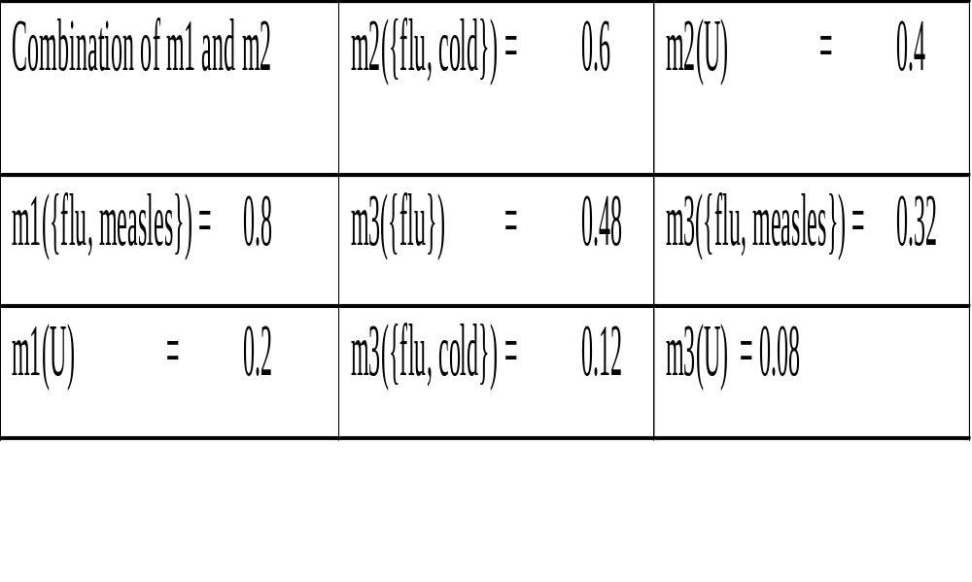
Cont…

Slide 71
Now previous belief functions are modified to m3 with the following belief values and are different from earlier beliefs.
m3({flu}) = 0.48
m3({flu, cold}) = 0.12
m3({flu, measles}) = 0.32
m3(U) = 0.08
Further, if we have another evidence function m4 of sneezing with the belief values as:
m4({cold, cough}) = 0.7
m4(U) = 0.3
Then the combination of m3 and m4 gives another belief function as follows:

Slide 72
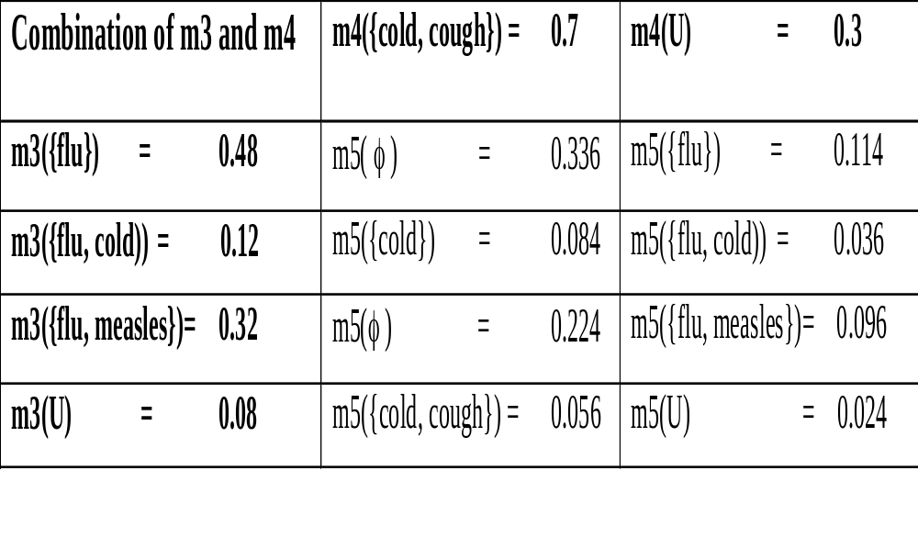
Cont…

Slide 73
Cont…
If we get empty set (φ) by intersection operation, then we have to redistribute any belief that is assigned to φ sets proportionately across non empty sets using the value (1 - ∑ A ∩ B = φ (m1(A) * m2(B))) in the denominator of belief values for non empty sets.
From the table we get multiple belief values for empty set (φ) and its total belief value is 0.56.
So according to formula, we have to scale down the remaining values of non empty sets by dividing by a factor ( 1 - 0.56 =0.44).

Slide 74
Cont…
m5({flu}) = (0.144/0.44 ) = 0.327
m5({cold}) = (0.084/0.44) = 0.191
m5({flu, cold}) = (0.036/0.44) = 0.082
m5({flu, measles})= (0.096/0.44) = 0.218
m5({cold, cough}) = (0.056/0.44) = 0.127
m5(X) = (0.024/0.44) = 0.055
While computing new belief we may get same subset generated from different intersection process. The ‘m’ value for such set is computed by summing all such values.

